Slide 1
BANK LOAN ANALYTICS PROJECT

Slide 2

INDEX
KPI 1 – Loan Amount Trend
KPI 2 – Revolving Balance by Grade
KPI 3 – Payment by Verification Status
KPI 4 – Loan Status Distribution
KPI 5 – Home Ownership & Payments
KPI 6 – Top 10 Loan Purposes
KPI 7 – Recovery Analysis by Grade
KPI 8 – Avg Annual Income vs Loan Amount
Dashboards
Challenges & Learnings
Notes:
This slide covers the initial steps crucial for any bank loan analytics project. Collecting accurate data, preprocessing it for quality, and engineering features set the foundation for meaningful analysis. Maintaining compliance and privacy is also essential during data handling.

Slide 3
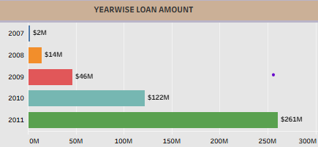
KPI 1: Loan Amount Trend by Year
Loan disbursement started very small in 2007 ($2M) and gradually increased.
By 2008 and 2009, lending volumes grew to $14M and $46M.
A major jump is seen in 2010 ($122M), showing rapid expansion in loan issuance.
The highest growth occurred in 2011 with $261M, more than double 2010.
Overall, loans show a strong upward trend, indicating rising customer demand and credit penetration.
Notes:
Risk assessment is at the heart of loan analytics. This slide discusses how credit scoring models are built and refined to predict the likelihood of loan default, leveraging various data sources and predictive methods.

Slide 4
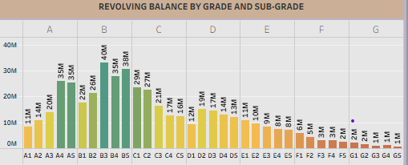
KPI 2: Revolving Balance by Grade & Sub-Grade
The highest revolving balances are concentrated in Grade B, especially sub-grades B3 ($40M), B4 ($38M), and B5 ($34M).
Grade A also holds significant balances, with sub-grades A4 ($20M) and A5 ($35M) leading.
Grade C shows moderate balances, with C1 ($29M) and C2 ($22M) as key contributors.
Grades D and E show declining balances, ranging from $14M to $6M, indicating lower loan activity.
Grades F and G have the least revolving balances (mostly < $5M), highlighting limited exposure but potentially higher credit risk.
Notes:
Monitoring the overall loan portfolio helps banks understand performance and emerging risks. This slide highlights how segmentation and visualization tools aid in proactive management.

Slide 5
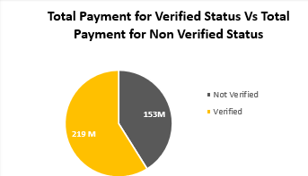
KPI 3 – Total Payment by Verification Status
Verified customers contribute a higher total payment of $219M.
Non-verified customers contribute $153M, which is lower despite similar loan availability.
Verified loans show greater repayment reliability compared to non-verified ones.
The difference highlights that verification reduces default risk and increases repayment performance.
Notes:
Effective customer segmentation allows banks to customize loan offerings and marketing efforts, improving acquisition and retention rates. This approach leverages analytics to better address customer needs.

Slide 6
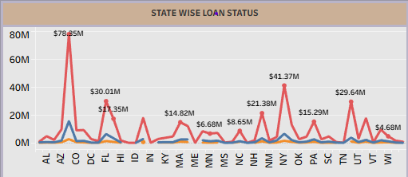
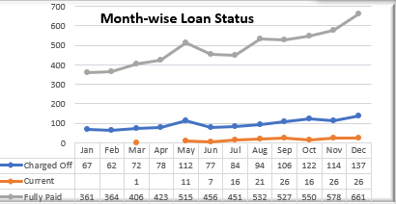
KPI 4 – Loan Status Distribution (State wise & Month wise)
(State wise):
California (CA), Texas (TX), and New York (NY) have the highest number of loans issued.
Midwestern states such as IL, OH, and MI show moderate loan distribution.
Several smaller states record relatively low loan volumes, indicating concentrated lending in key regions.
Default and late payment statuses are also more visible in high-loan states like CA and TX.
(Month wise):
Loan issuances show seasonal variation, with dip in Q2 (Apr–Jun).
December consistently shows a peaks, possibly due to year-end/holiday effects.
Overall trend indicates increasing loan activity year-over-year.
Notes:
This slide addresses the importance of compliance in bank loan analytics, emphasizing transparent reporting, regulatory adherence, and fraud prevention measures to safeguard the institution.

Slide 7
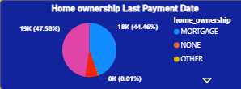
KPI 5 – Home Ownership vs Last Payment Date
Mortgage holders form the largest share of active loans and continue repayments up to the latest available dates.
Own Home customers also show consistent repayment timelines, indicating financial stability.
Renters have comparatively fewer loans, and repayment activity tends to taper off earlier than mortgage/own home groups.
The most recent payment dates are dominated by Mortgage and Own Home categories, while Renter loans decline faster.
Notes:
Effective customer segmentation allows banks to customize loan offerings and marketing efforts, improving acquisition and retention rates. This approach leverages analytics to better address customer needs.

Slide 8
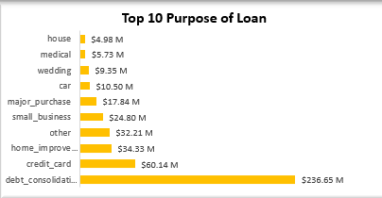
KPI 6 – Top 10 Loan Purposes
Debt Consolidation dominates as the largest loan purpose, accounting for the majority of loan amounts.
Credit Card loans are the second highest category, reflecting consumer spending patterns.
Home Improvement ranks third, showing demand for personal property upgrades financed through loans.
Other notable categories include Major Purchase, Medical, and Small Business loans, though they are comparatively smaller.
The “Other” category is minimal, suggesting most loans fall under well-defined purposes.
Notes:
Effective customer segmentation allows banks to customize loan offerings and marketing efforts, improving acquisition and retention rates. This approach leverages analytics to better address customer needs.

Slide 9
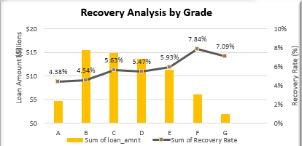
KPI 7 – Recovery Analysis by Grade
Grade A and B loans show the highest recovery amounts and rates, indicating strong repayment performance.
Grades C and D display moderate recoveries, but the recovery rate drops compared to premium grades.
Grades E, F, and G contribute minimal recoveries, reflecting weaker repayment capability.
A clear inverse relationship exists: as credit grade decreases, the recovery rate falls sharply.
Notes:
Effective customer segmentation allows banks to customize loan offerings and marketing efforts, improving acquisition and retention rates. This approach leverages analytics to better address customer needs.

Slide 10
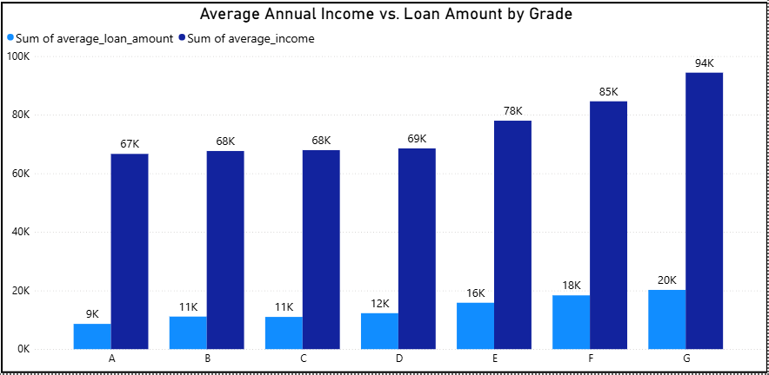
KPI 8 – Avg Annual Income vs Avg Loan Amount (by Grade)
Higher credit grades (A & B) show higher average annual incomes paired with moderate loan amounts, reflecting strong repayment capacity.
Mid-level grades (C & D) display a balance between income and loan size, but repayment risk begins to increase.
Lower grades (E, F, G) reveal lower incomes with relatively high loan amounts, suggesting income-loan mismatch.
This pattern indicates that customers in riskier grades are often over-leveraged compared to their earnings.
Notes:
Effective customer segmentation allows banks to customize loan offerings and marketing efforts, improving acquisition and retention rates. This approach leverages analytics to better address customer needs.

Slide 11
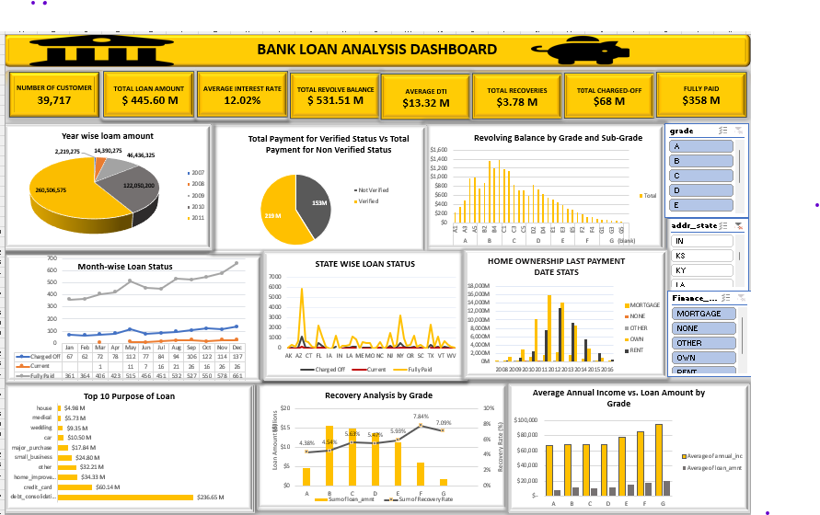
EXCEL DASHBOARD
Notes:
Effective customer segmentation allows banks to customize loan offerings and marketing efforts, improving acquisition and retention rates. This approach leverages analytics to better address customer needs.

Slide 12
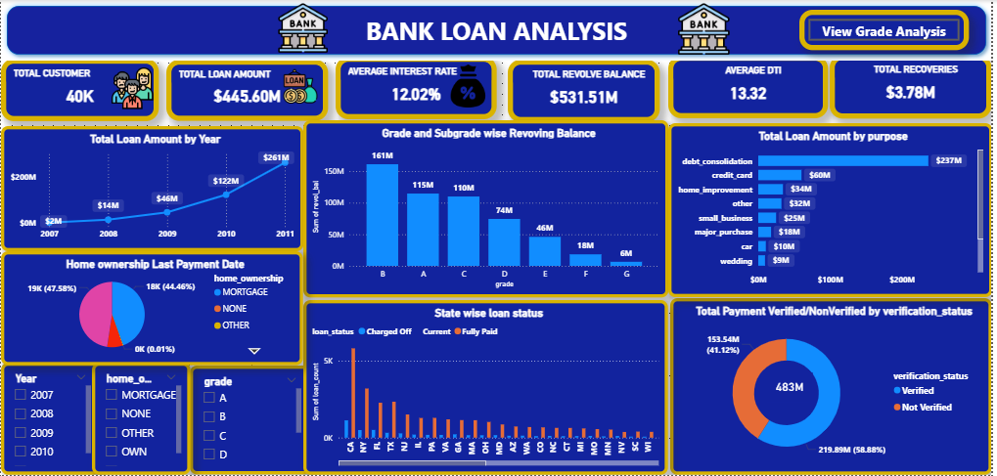
POWER BI DASHBOARD
Notes:
Effective customer segmentation allows banks to customize loan offerings and marketing efforts, improving acquisition and retention rates. This approach leverages analytics to better address customer needs.

Slide 13
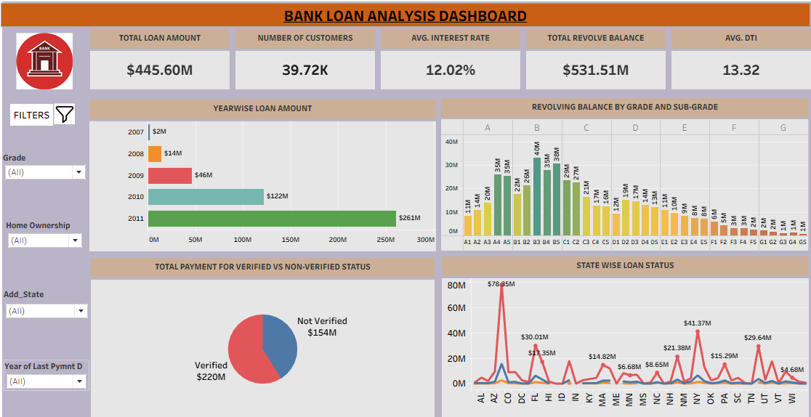
TABLEAU DASHBOARD
Notes:
Effective customer segmentation allows banks to customize loan offerings and marketing efforts, improving acquisition and retention rates. This approach leverages analytics to better address customer needs.

Slide 14
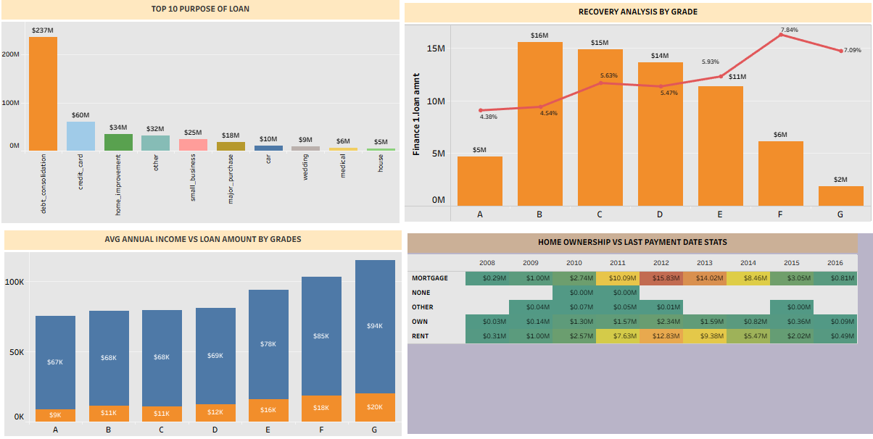
TABLEAU DASHBOARD
Notes:
Effective customer segmentation allows banks to customize loan offerings and marketing efforts, improving acquisition and retention rates. This approach leverages analytics to better address customer needs.

Slide 15
SQL QUERY
Notes:
Effective customer segmentation allows banks to customize loan offerings and marketing efforts, improving acquisition and retention rates. This approach leverages analytics to better address customer needs.

Slide 16

Challenges & Learnings
Challenges:
Cleaning & formatting raw finance data
Complex SQL query building for KPIs
Power BI visual alignment & interactivity
Learnings:
Stronger SQL query writing skills
Hands-on practice with Excel dashboards
Proficiency in Power BI reporting
Better understanding of financial KPIs & insights
Notes:
Effective customer segmentation allows banks to customize loan offerings and marketing efforts, improving acquisition and retention rates. This approach leverages analytics to better address customer needs.

